Slide 1

HELP, SAVE BUTTERCUP!
Mechatronic Ball Sorting & Game Ecosystem
Engineering Project Defense
MCT231 · Faculty of Engineering · Ain Shams University

Slide 2

Introduction
"Help. Save Buttercup!" is an interactive, gamified mechatronic toy that turns standard arithmetic practice into a.. physical rescue mission.
This game tackles the loss in engagement children experience when learning math through repetitive paper worksheets and assignments by transforming the process into a rewarding play experience.
Mowahed Mohamed Mohamed Mohamed 24P0302 Ahmed Mohammed Youssef Ibrahim Eidarous 24P0079 Abdulrahman Khaled Ahmed Elish 24P0465 Gana Khalid Abdelwahab 24P0251 Yehia Mohammed Fawzy Ebrahim Emera 24P0322

Slide 3


User Research
Children in the age range from 2 to 10 years old require physical interaction to maintain focus on educational tasks; additionally, having a clear goal that lets them know what success is like minimizes frustration and off-task behaviors.
After careful considerations we decided to map specific math operations to physical ball colors (Blue for Addition, Red for Multiplication) and made a clear target goal ,that is to deplete Mojo JoJo 10 Hp Bar, to the feedback loop to maximize retention and engagement.

Slide 4

Design Challenge
Engineering a fully autonomous, closed-loop mechanical system that seamlessly synchronizes with a digital educational interface, without requiring adult intervention to reset.
If a toy jams or requires constant manual reloading, the child's immersion breaks and the educational value is lost. A self-recycling loop ensures the user can focus entirely on the math challenges and the narrative.

Slide 5

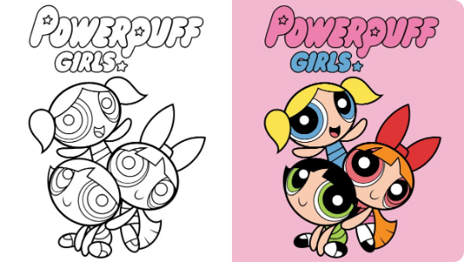
Toy Description and Functionality
Mojo Jojo's Hostage Situation
Townsville's toughest fighter, Buttercup, has been kidnapped by Mojo Jojo. The city's only hope lies in an automated defense system coordinated by her sisters, Blossom and Bubbles.
This project transforms a traditional mechatronic ball-sorting task into a narrative-driven game experience. Players must engage with the system to solve mathematical challenges and deplete Mojo Jojo’s health points through hardware-software synergy.

Slide 6
Toy Description and Functionality
Mechanical Elements:
Intake & Sorting: A rotating turnstile regulates ball entry. An SG90 Servo actuates a custom 15g claw to physically split and route balls based on their color.
Shooting Mechanism: A stepper motor provides ±45° rotation for aiming at the target boxes, followed by a DC motor that launches the ball.
Electromechanical Support Mechanism: A high-torque servo arm acts as a vertical lifter, translating the balls 40cm upwards to automatically return them to the turnstile.
Electrical and Control Elements:
Simulated and mapped using Proteus, the system relies on a Master/Slave Dual-Arduino architecture.
Sensor System: A TCS3200 sensor detects the ball's color to trigger the correct math question. A network of 5 IR sensors tracks the ball's physical location through the turnstile, lifter, and target boxes.
Interaction: An HC-06 Bluetooth module links the physical toy's sensor data to the digital Processing game app on a desktop.

Slide 7

THE CLOSED-LOOP ECOSYSTEM
2. Sensing
4. Action
TCS3200 identifies ball color (Red/Blue).
Stepper aims & DC motor launches ball.
1. Intake
3. Sorting
5. Lift
Turnstile receives ball from return track.
SG90 Claw routes ball based on color.
High-torque servo recycles ball to top.

Slide 8






MECHANICAL ARCHITECTURE
Ball Turnstile
Sorter Claw
Shooter Base
Vertical Lift
40mm radius PLA+ sweep rotating 120° in 0.5s for precise intake control.
Custom made 15g claw routing balls to designated shooting reservoirs.
Stepper-driven platform offering ±45° aiming precision for targets.
40cm vertical translation via high-torque servo arm recycling mechanism.

Slide 9


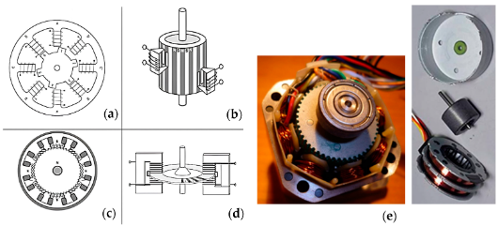
SHOOTER
2048 Steps Resolution
The 28BYJ-48 Stepper Motor provides high torque and precise angular positioning (±1.8°) for the shooter base.
A high-RPM DC motor propels balls into targets, with trigger timing synchronized via the Processing app interface.

Slide 10

Lifter
High-Efficiency Recycling
40cm
The system completes the closed loop by translating balls 40cm vertically back to the intake turnstile. This is achieved via a dedicated IR-triggered high-torque servo mechanism.
Lifting Height
The integration of two IR sensors (at the base and top) ensures the motor only actuates when a ball is present.

Slide 11
Game Logic
Blossom (Red Ball) Multiplication prompts. Success deals -2 HP damage to Mojo Jojo. Higher difficulty, higher reward.
Bubbles (Blue Ball) Addition prompts. Success deals -1 HP damage. Reliable and steady progress toward the goal.
Winning State 10 HP boss bar tracking. Real-time feedback on 16x2 LCD and Processing UI upon Mojo Jojo's defeat.

Slide 12
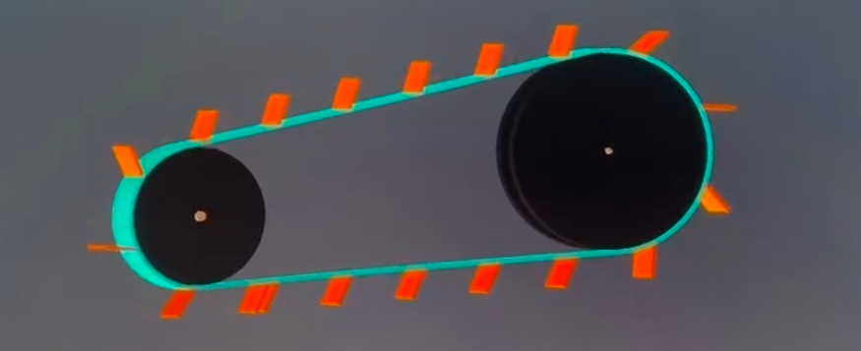
Prototyping and Iteration
The physical build utilized PLA+ printed parts, Wooden parts manufactured by laser cutting, standard servos, and a unified 12V power supply.
There were several iterations to the lifting mechanism in our project; at the start it was a conveyor belt but midway through we realized that it was hard to implement at our skill level and knowledge.
After that we used a lifting arm with a servo motor. After some trials we realized that the mechanical connections holding the servo motor and the arm were not applicable so finally we changed it to our current mechanism

Slide 13

Safety Considerations
Low Voltage: The entire toy operates on a closed 12V DC power supply which isn’t dangerous even if it was in direct contact with a person
Enclosed Mechanisms: The DC shooting motors and high-torque lifter servos are housed within the chassis to prevent the small fingers from being pinched.
Sharp edges : There aren’t any sharp edges present in the project
Material Safety: Constructed with non-toxic PLA+.

Slide 14

Educational Impact
Educational Benefits: The toy dynamically adapts to the physical ball sorted, directly tying tactile play to cognitive math development.
Skill Development:
Blue Balls (Bubbles): Triggers foundational Addition equations. Success builds math confidence and deals 1 HP of damage to Mojo jojo.
Red Balls (Blossom): Triggers Multiplication equations, for a higher reward of 2 HP damage.

Slide 15
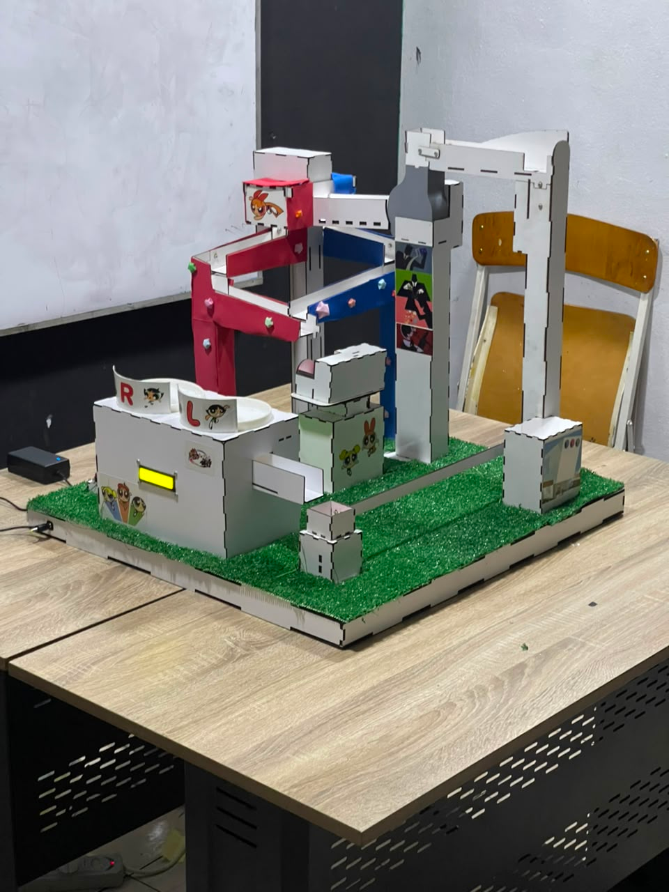
Final Product
The child inserts a ball into the system. The digital UI displays a math challenge based on the ball's color; finally, the child aims at the right or left directions and shoots to register that number as his answer.
the app deducts health from Mojo Jojo's 10 HP bar, and the electromechanical lift auto-recycles the ball for continuous play.

Slide 16

Conclusion
To summarize, "Help. Save Buttercup!" successfully bridges the gap between mechatronic engineering and early childhood education.
By automating the reset process and tying physical accuracy to a digital narrative, we have proven that foundational math practice can be as thrilling as defeating a supervillain.
.

Slide 17
Q&A
Buttercup is Saved!
Thank you for your attention. We are ready to discuss the mechanical, electrical, and software nuances of our automated ball sorting ecosystem.

